Slide 2
Unit 2
Social interactions and economic outcomes

Slide 3
Outline

Slide 4
Outline
Introduction
Social Dilemmas
Self-interest and Economic Outcomes
Social Preferences and Free Riding
Conflicts of Interest and Bargaining
Application: Global Climate Change Problem

Slide 5
Introduction
SECTION A

Slide 6
The context for this Unit
Institutions play a key role in determining economic outcomes, including inequality and growth (Unit 1)
Individuals motivated by self-interest can produce outcomes that are beneficial for society e.g. entrepreneurship, innovation (Unit 1)
External effects arise when actions taken by a person have consequences—benefits or costs—that are felt by others (Unit 1)
But self-interest can also be harmful to society.
Why do these problems arise?
What can we do about it?

Slide 7
Self-Interested Individuals
“It is not from the benevolence of the butcher, the brewer, or the baker that we expect our dinner, but from their regard to their own self-interest. We address ourselves not to their humanity but to their self-love, and never talk to them of our own necessities, but of their advantages.”
--- Adam Smith, Wealth of Nations (1776)

Slide 8
The “Invisible Hand”
“Every individual necessarily labors to render the annual revenue of the society as great as he can... He is in this, as in many other ways, led by an invisible hand to promote an end which was no part of his intention... By pursuing his own interest, he frequently promotes that of the society more effectually than when he really intends to promote it.”
--- Adam Smith, Wealth of Nations (1776)

Slide 9
This Unit
When self-interest works and when it doesn’t
Public goods and the problem of free riding
Conflicts of interest and bargaining
Application: The global climate change problem
Economic tools:
Game theory: players, strategies, payoffs
Predicting outcomes: Nash equilibria
Analyising preferences through behavioral experiments

Slide 10
Social Dilemmas
SECTION B

Slide 11
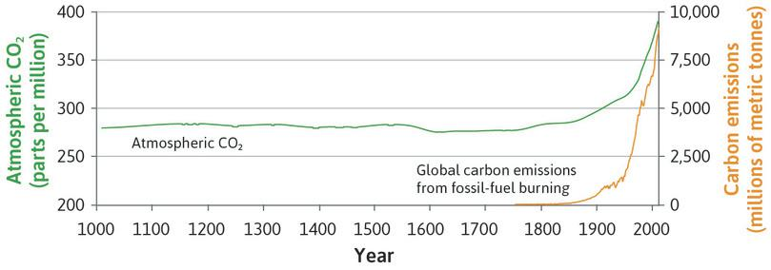
Social dilemma
Social dilemma = a situation in which actions taken independently by self-interested individuals result in a socially suboptimal outcome e.g. traffic jams, climate change.
One of the tasks of public policies is to address social dilemmas

Slide 12
The tragedy of the commons
Hardin‘s example: Cattle herders each raise ever-larger herds, eventually overgrazing their pastureland.
Common-pool resources = resources that are shared, not owned by anyone
Resources of this type (e.g. the earth’s atmosphere or fish stocks) are easily overexploited unless we control access in some way
But if you reduce your carbon footprint, or limit the number of tuna you catch, you will bear the costs, while others will enjoy the benefits
Free riding = Benefiting from the contributions of others to some cooperative project without contributing oneself (e.g. group assignments at college)

Slide 13
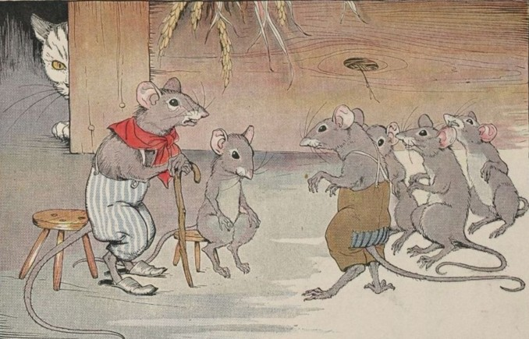
Resolving social dilemmas: Preferences
Social preferences
A person with these preferences cares about the implications for other people. Given the chance he would prefer to help some other person, even if it cost something to do so.
Countless examples of willingness, or even desire, to help others, even at cost to oneself – for example during wars, natural catastrophes.
Who will be the cat?
Notes:
Image source: http://mythfolklore.net/aesopica/milowinter/6.htmI
llustrations by Milo Winter (1886-1956). Available online at Project Gutenberg.

Slide 14
Resolving social dilemmas: Policies
Public policies in the form of quotas and taxes:
Quotas to prevent the over-exploitation of stocks of cod in the North Atlantic
Landfill tax in the UK has reduced the amount of waste that is dumped in landfills
Local communities can create their own institutions to regulate behaviour, for example:
Customary rules designed by farmers in Valencia, Spain, and the Tribunal de las Aguas (Water Court) to resolve conflicts

Slide 15
Self-interest and Economic Outcomes
SECTION C

Slide 16
Game theory: Key concepts
Social interaction: A situation in which the actions taken by each person affect other people’s outcomes as well as their own.
Strategic interaction: A social interaction in which the participants are aware of the ways that their actions affect others (and the ways that the actions of others affect them).
Strategy: An action (or a course of action) that a person may take when that person is aware of the mutual dependence of the results for herself and for others.

Slide 17
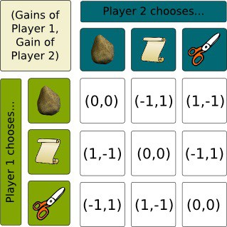
Game
A game describes a social interaction:
Players – who is involved in the interaction
Feasible strategies - actions each player can take
Information – what each player knows when choosing their action
Payoffs – outcomes for every possible combination of actions
Notes:
Image source: http://www.naturphilosophie.co.uk/winning-rock-paper-scissors-lizard-spock/

Slide 18
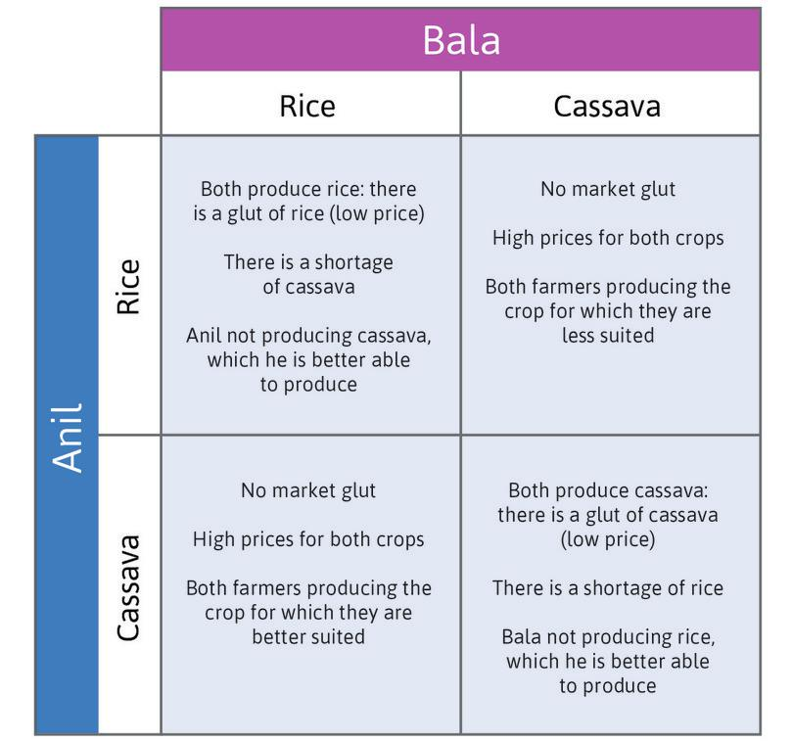
Example: Crop choice
Two farmers decide which crop to specialize in.
They interact only once (one-shot game).
Players – Anil and Bala
Feasible strategies – Rice or Cassava
Information – each farmer does not know what the other chooses
Payoffs – depend on market prices and quality of land

Slide 19
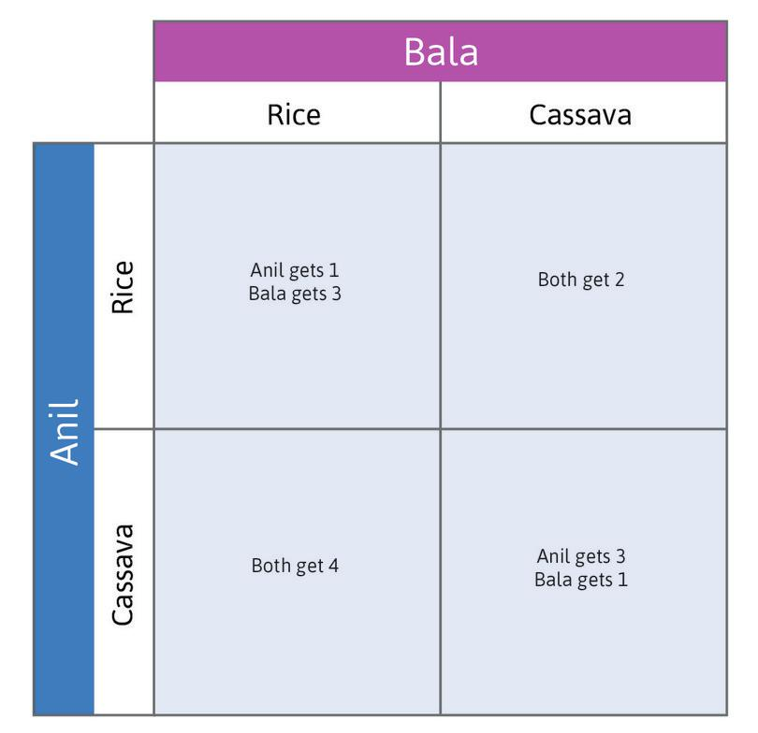
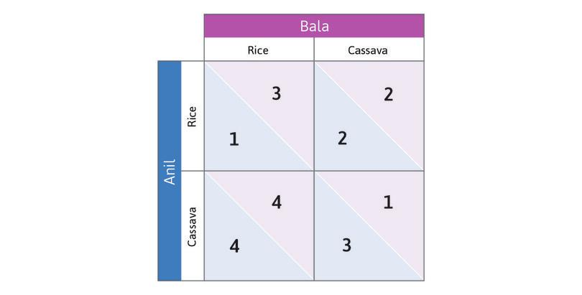
Interpreting the payoff matrix
Payoff matrix = A table of the payoffs associated with every possible combination of strategies chosen by two or more players in a game
Notes:
Because the market price falls when it is flooded with one crop, they can do better if they specialize compared to when they both produce the same good. When they produce different goods, they would both do better if each person specialized in the crop that was most suitable for their land.

Slide 20

Understanding best responses
We can use the payoff matrix to analyse what action a player would choose if he knew what the other player will do.
Best response: The strategy that will give a player the highest payoff, given the strategies that the other players select.
If Bala chooses Rice, Anil’s best response is to choose Cassava—that gives him 4, rather than 1.

Slide 21
Understanding dominant strategies
If Bala chooses Cassava, Anil’s best response is to choose Cassava—that gives him 3, rather than 2.
Regardless of what Bala chooses, it is therefore optimal for Anil to grow Cassava – this is his dominant strategy.
Dominant strategy: Action that yields the highest payoff for a player, no matter what the other players do.
Note that a dominant strategy need not always exist

Slide 22
Dominant strategy equilibrium
Similarly, Bala’s dominant strategy is to grow Rice.
When Anil and Bala each play their dominant strategy, the outcome is (Cassava, Rice).
Dominant strategy equilibrium: An outcome of a game in which every player plays his or her dominant strategy.
Note that a dominant strategy need not always exist

Slide 23
The invisible hand
The pursuit of self-interest without regard for others is sometimes considered to be morally bad, but the study of economics has identified cases in which it can lead to outcomes that are socially desirable.
Simply pursuing their self-interest—choosing the strategy for which they got the highest payoff—resulted in an equilibrium outcome that was:
the best of the four possible outcomes for each player
the strategy that yielded the largest total payoffs for the two farmers combined.

Slide 24
The prisoner’s dilemma
There are other cases, however, in which the pursuit of self-interest leads to results that are not in the self-interest of any of the players.
Prisoners’ dilemma = A game in which the payoffs in the dominant strategy equilibrium are lower for each player, and also lower in total, than if neither player played the dominant strategy.
In this case, the socially optimal outcome is not achieved by people individually pursuing their own self-interest.

Slide 25
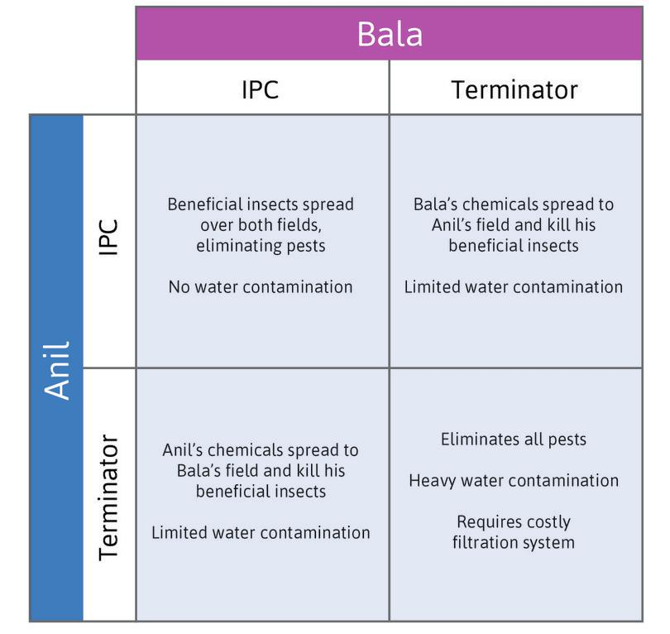
Example: Pesticide choice
Two farmers decide how to deal with pest insects
Players – Anil and Bala
Feasible strategies – Terminator or Integrated Pest Control (IPC)
Information – each farmer does not know what the other chooses
Payoffs - depend on the resulting combination of pest control instruments

Slide 26
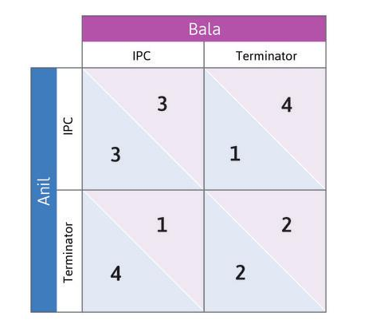
Equilibrium in the pesticide game
When Anil and Bala each play their dominant strategy, the outcome is (Terminator, Terminator). This is the dominant strategy equilibrium.
Anil and Bala each receive payoffs of 2, but both would be better off if they both used IPC instead. The predicted outcome is therefore not the best feasible outcome.

Slide 27
Why did we predict this outcome?
Players only care about their own payoffs.
Introduce social preferences
Nobody could make players pay for the consequences of their actions on others.
Introduce repeated games, social norms, and peer punishment
Players could not coordinate their actions beforehand.
Change the rules of the game (institutions and policies)

Slide 28
Social Preferences and Free Riding
SECTION D

Slide 29
Social preferences
People generally care, not only about what happens to themselves, but also what happens to others. Then we say that the individual has social preferences.
Social preferences: Preferences that place a value on how your actions affect other people as well as yourself.
Social preferences are not necessarily a good thing.
For example, they can take the form of hatred of people of a different race or religion.

Slide 30
Learning about preferences
Survey questions (problem: subjective answers)
Statistical studies of economic behaviour (problem: cannot control the decision-making environment in which preferences were revealed)
Lab experiments:
Can create a control/treatment group for comparison
Results can be replicated
Field experiments:
Lab experiments may not predict real-world decision making
More realistic context in which people make decisions

Slide 31
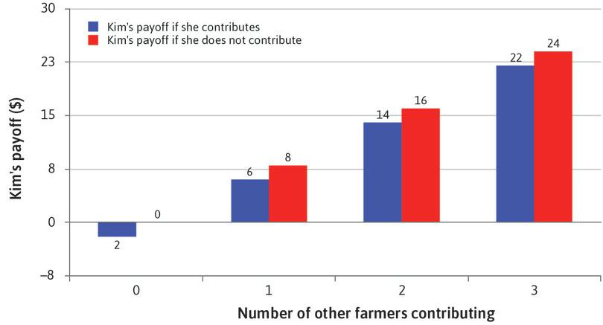
Example: Public goods game
Public good = A good for which use by one person does not reduce its availability to others (also called a non-rival good)
Each farmer decides whether to contribute to the public good (e.g. irrigation project)
Contributing has a personal cost of $10, but everyone benefits from this (by $8 each)
Not contributing is a dominant strategy.
Here, Kim (one farmer) can free ride on others’ contributions.

Slide 32
Repeated games
We have so far looked at one-shot games.
Better outcomes can arise in repeated interactions due to social norms, reciprocity, and peer punishment.
Behaving selfishly in one period has consequences in future periods, so it may no longer be a dominant strategy.

Slide 33
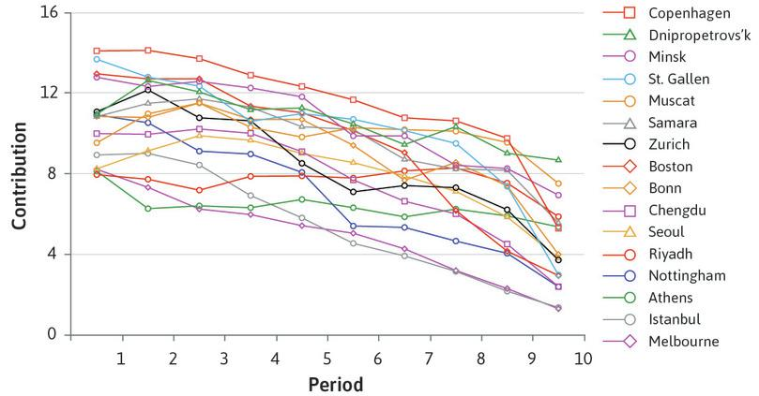
Reciprocity and social norms
Lab experiment: Participants play ten rounds of a public good game.
In each round, the people in the experiment are given $20.
They are randomly sorted into small groups.
They are asked to decide on a contribution from their $20 to a common pool of money.
For every dollar contributed, each person in the group receives $0.40, including the contributor.
A disappointed expectation of reciprocity is the most convincing explanation of why contributions fell in later rounds.

Slide 34
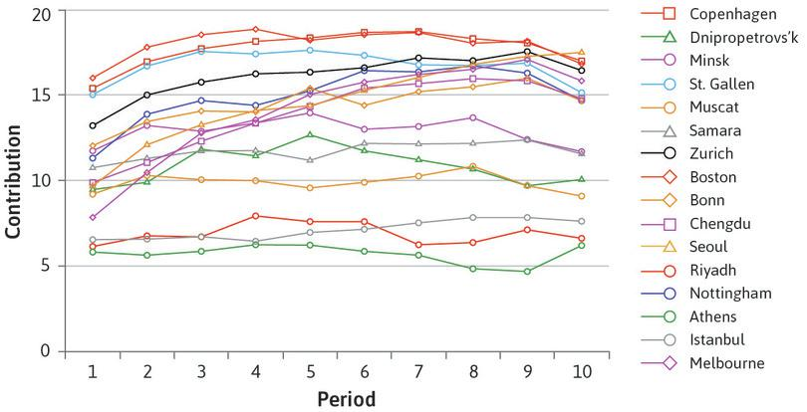
Peer punishment
After observing the contributions of their group, individual players could pay to punish other players by making them pay a $3 fine.
The punisher remained anonymous but had to pay $1 per player punished.
Experiment shows that even in large groups of people, a combination of repeated interactions and social preferences can support high levels of contribution to the public good.

Slide 35
Social preferences and social dilemmas
3 kinds of social preference can explain how people play the public goods game with punishment:
Altruism: A willingness to help someone else at a cost to yourself.
Reciprocity: A desire to help those who have (in your opinion) acted well, and to harm those who have acted poorly.
Inequality aversion: Disliking outcomes in which some individuals receive more than others (especially if others are doing better than you).

Slide 36
Conflicts of interest and Bargaining
SECTION E

Slide 37
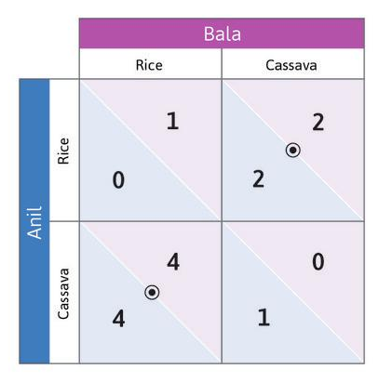
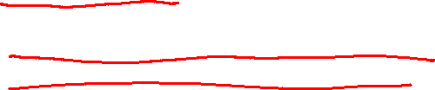
Introducing Nash equilibria
Crop game with different payoffs
In many other games, players do not have dominant strategies.
For exmple, your best response of which side to drive will depend on what the others choose to do.
Nash equilibrium: a set of strategies, one for each player in the game, such that each player’s strategy is a best response to the strategies chosen by everyone else.
In the driving game, and in this new crop game, there are two Nash equilibria!

Slide 38
Bargaining to resolve problems
People commonly resort to negotiation to solve their economic and social problems. For example, international negotiation resulted in the Montreal Protocol, which eliminated the use of CFCs.
But we know negotiations can fail. The economy may end up ‘stuck’ in a Nash equilibrium in which all players are worse off.
Situations with two Nash equilibria prompt us to ask two questions:
Which equilibrium would we expect to observe in the world?
Is there a conflict of interest because one equilibrium is preferable to some players, but not to others?

Slide 39
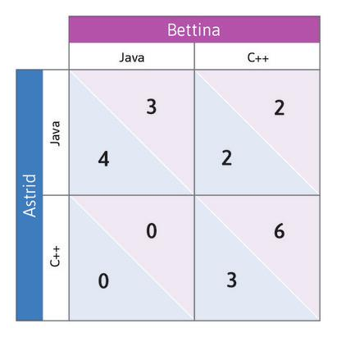
Conflicts over which equilibrium will occur
There may be mutual gains to getting to one or the other of these equilibria, but who gets the lion’s share of these gains may differ among the outcomes.
Example:
Two software engineers both do better if they work in the same language.
Astrid does better if the language is Java, while the reverse is true for Bettina.
Two Nash equilibria: both choose Java or both choose C++.
The outcome might be determined by:
Which of the two has more power?
Who started work on the project first?

Slide 40
Application: Global Climate Change Problem
SECTION F

Slide 41
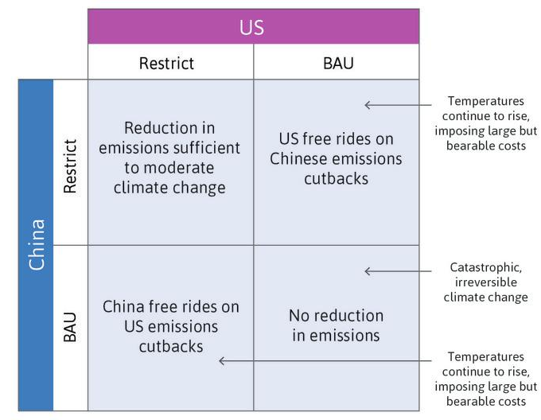
The climate change game…
The worst outcome for both countries is that both persist with BAU, running a significant risk of human extinction.
The best for each is to continue with BAU and let the other one Restrict.
The only way to moderate climate change significantly is for both to Restrict.

Slide 42
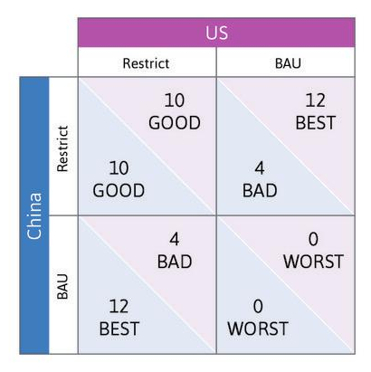
…as an example of a hawk-dove game
There are two Nash equilibria: They differ on which country bears the cost of restricting emissions.
These two Nash equilibria are such that the two players adopt different strategies.
Negotiations are bound to be difficult, since each country would prefer the other to take the lead on restricting carbon emissions.
The game represents the idea that no one wants to see catastrophic climate change, but each is waiting in order to see if others will move first.

Slide 43

Using public policy to change the game
Goal: Change the game so that (Restrict, Restrict) becomes a Nash equilibrium.
Sustainable consumer lifestyles using fewer goods and services of the kind that result in environmental degradation.
Governments could stimulate innovation and the diffusion of cleaner technologies: They might do this by, for example, raising the price of goods and services that result in carbon and other emissions through taxes.
A change in norms: Citizens, non-governmental organizations (NGOs), and governments can promote a norm of climate protection and sanction or shame countries that do nothing to limit climate change.
Countries can share the costs of Restrict more evenly. An example would be paying countries in the Amazon basin to conserve the rainforest.

Slide 44
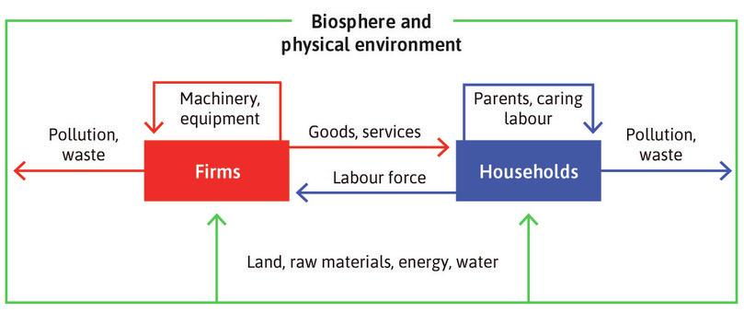
The economy and economics
Our social nature poses an enormous challenge: how can we organise our interactions in such a way that the outcomes are acceptable?
Economics studies how people interact with each other and with their natural surroundings in providing their livelihoods, and how this changes over time.

Slide 45
Summary
Social interactions offer opportunities for mutual gains, but conflicts arise over how these gains should be distributed.
Preferences and policies to address social dilemmas
The individual pursuit of self-interest can lead to socially beneficial outcomes, but can also produce undesirable outcomes
Game theory has helped us model strategic interactions
Players choose best responses to others’ strategies
The rules of the game matter for outcomes
Multiple Nash equilibria can cause coordination problems

Slide 46
In the next unit
Evaluating outcomes of social interactions: efficiency and fairness
Analysing the causal effect of public policies such as:
Child health programs
Anti-obesity taxes
Intellectual property rights
New type of games: sequential games and the use of game trees

